Slide 1
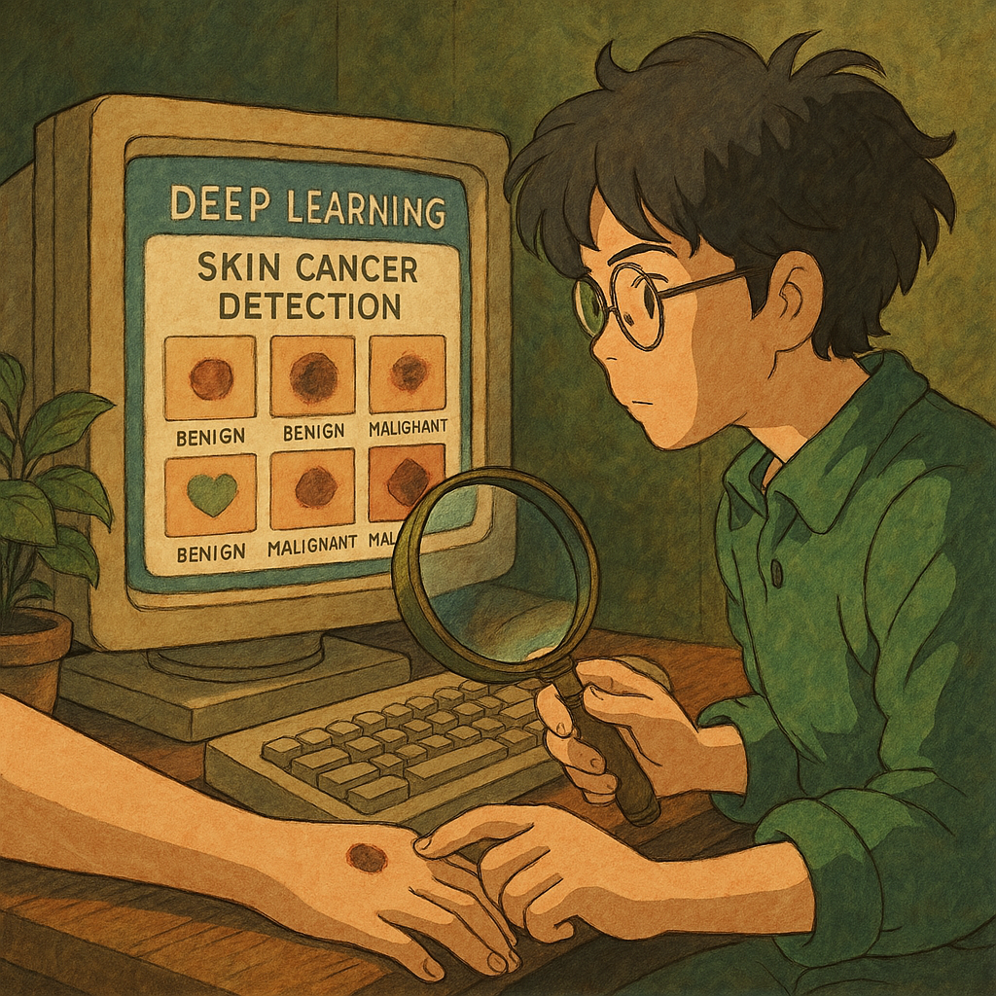
Skin Lesion Classification for Melanoma
Final Presentation
By: Alessandra, Celine, Eduardo, Maria, and Alejandro
Date: 04/07/2025
AI_700_001_BK_SPRING2025

Slide 2
OUTLINE
Introduction
Application
Literature Review & Results
Dataset Exploration
Data Preprocessing & Balancing
Algorithm & Model Architecture
Understanding the Functions
Training & Evaluation Results
Challenges & Solutions
Model Results
Future Work
Conclusion
Q&A

Slide 3
INTRODUCTION
What is melanoma and why is it dangerous?
Why early detection is critical
Challenges in manual diagnosis
Role of AI in skin lesion classification
Goal of this project
Notes:
“Melanoma is a serious form of skin cancer that can spread rapidly if not detected early.”
(You can also throw in a stat like: "It accounts for 75% of skin cancer deaths despite being less common.")
“Early detection can significantly improve survival rates, but manual diagnosis is often difficult and time-consuming.”
“Dermatologists use visual inspection and dermatoscopy, but even experienced professionals can find it hard to distinguish between certain lesion types.”
“This is where Artificial Intelligence can help — by assisting in classifying skin lesions using medical images and patient data.”
“Our goal in this project is to build a deep learning model that can accurately classify different types of skin lesions, including melanoma, using both image and patient metadata.”

Slide 4
APPLICATION
Real-world need for automated skin lesion detection
Reducing diagnostic workload for dermatologists
Improving access to healthcare in underserved areas
Potential mobile/clinical deployment
Supporting early intervention and treatment
Notes:
“There’s a growing need for automated systems to assist in skin lesion detection, especially as skin cancer rates rise globally.”
“Our model can help reduce the workload on dermatologists by acting as a second opinion tool — flagging high-risk cases for further review.”
“It’s also valuable in places where access to specialists is limited — for example, in rural areas or developing countries.”
“Since our model uses both image and patient data, it could be integrated into mobile apps or clinical decision support systems to assist in early diagnosis.”
“This can lead to earlier intervention, which significantly increases survival chances, particularly for melanoma.”

Slide 5
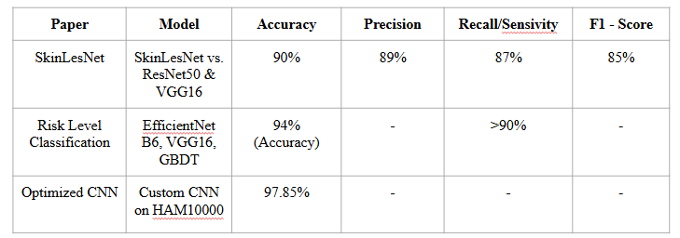
LITERATURE REVIEW & RESULTS
SkinLesNet excelled across multiple datasets, especially with smartphone images.
Rahman & Smith emphasized explainability and robust evaluation.
The Optimized CNN achieved high accuracy but noted misclassifications and ambiguity in some predictions.

Slide 6
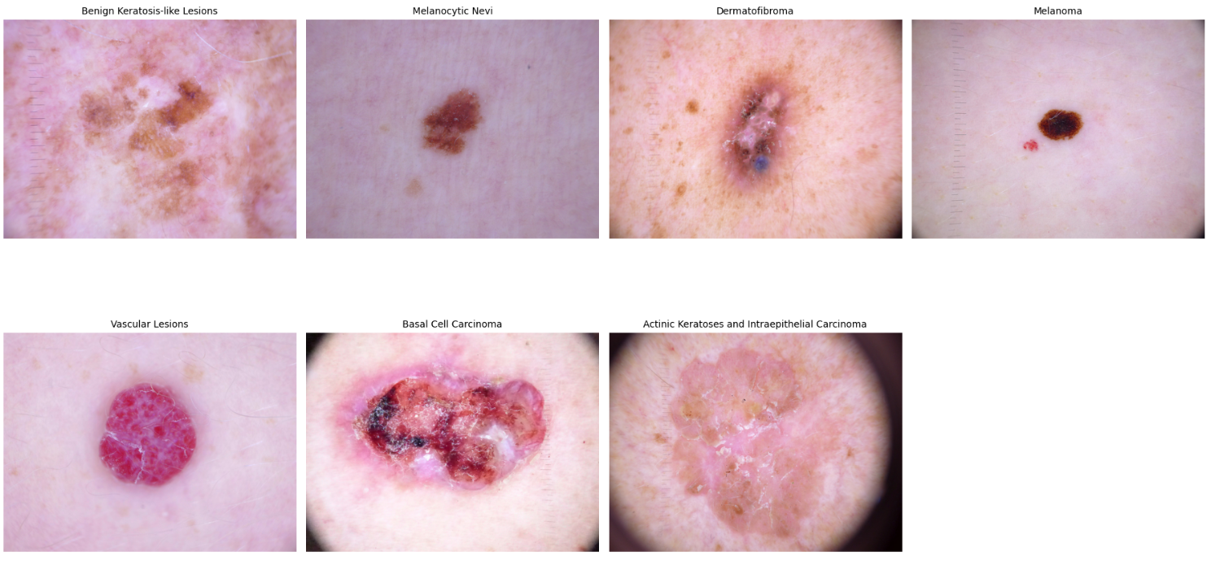
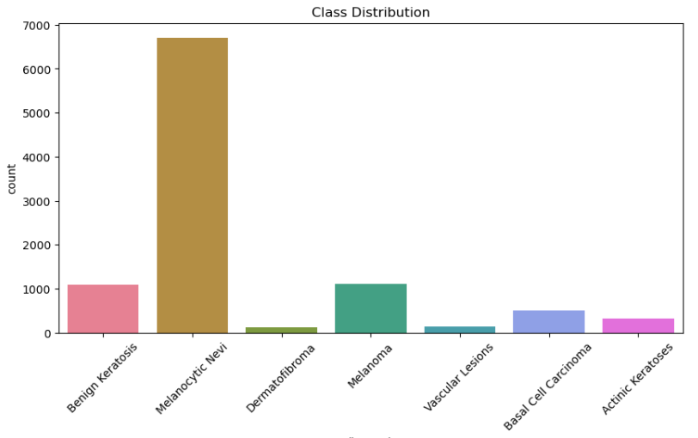
DATASET EXPLORATION
Notes:
“For this project, we used the HAM10000 dataset — a widely-used benchmark in skin lesion classification.”
“It contains over 10,000 high-quality dermatoscopic images, labeled into 7 skin lesion categories, including melanoma, benign nevi, and others.”
“Each image is also paired with metadata, including the patient’s age, sex, and body part where the lesion is located — which we later use in our model.”
“One major challenge we identified early on was the class imbalance — for example, ‘melanocytic nevi’ made up the majority of the dataset, while rare classes like ‘vascular lesions’ had far fewer samples.”
“Here on the slide, you can see sample lesion images and a bar chart showing the distribution of each class, which informed our data balancing strategy.”

Slide 7
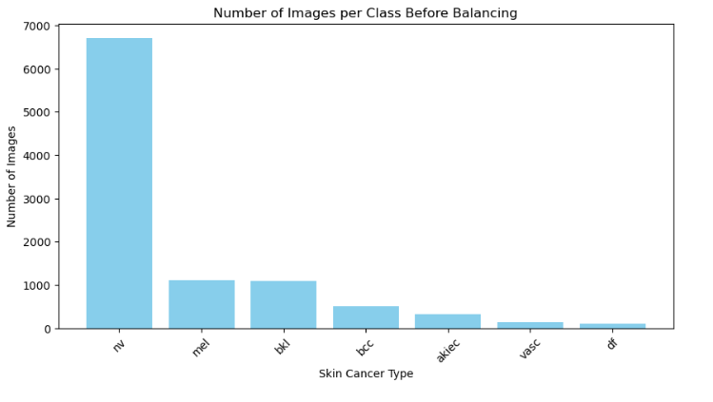
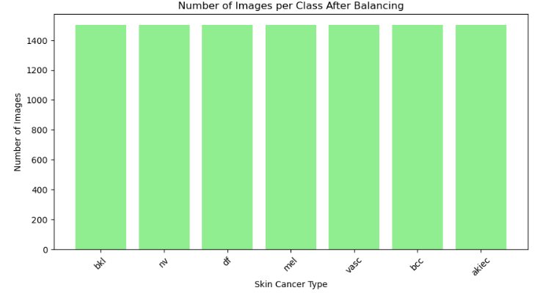
DATA PREPROCESSING AND BALANCING
Notes:
“Before training our model, we needed to clean and prepare the dataset. This involved handling missing values — we filled in missing age values with the median and assigned 'unknown' to missing sex and localization data.”
“We then created tabular features from the metadata. Age was scaled using StandardScaler, and sex and localization were converted into numerical format using one-hot encoding.”
“One major challenge we encountered was class imbalance — some classes had thousands of images, while others had just a few hundred.”
“To address this, we used a mix of undersampling for overrepresented classes and data augmentation for underrepresented ones. Specifically, we applied random image rotations to generate new, synthetic samples.”
“We balanced the dataset so that each of the 7 classes had 1,500 images, resulting in a total of 10,500 samples — this helped reduce model bias and improved training stability.”

Slide 8
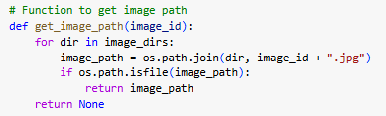
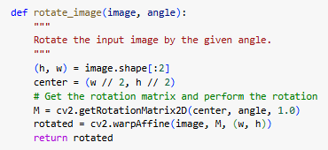
UNDERSTANDING THE FUNCTIONS
data_generator() – Custom generator for multi-input batches
Encodes labels using LabelEncoder
Combines tabular and image features for training
Notes:
“To build our pipeline, we implemented several custom functions to manage the dataset and feed it into the model efficiently.”
“The get_image_path() function searches through two image directories to find and match each image ID from the metadata. This ensures we load the correct file paths for every sample.”
“We created a function called rotate_image() that randomly rotates images by small angles — this was key for our augmentation strategy when oversampling underrepresented classes.”
“We also developed a data_generator() function to load batches during training. Since our model takes both images and tabular data, this generator reads images, retrieves the corresponding tabular features, and formats them together in each batch.”
“To prepare the labels, we used LabelEncoder to convert the diagnosis strings into integers for training, which are then used in the softmax output layer.”

Slide 9
CHALLENGES AND SOLUTIONS
Challenges | Solution
Class Imbalance | Oversampling + rotation-based augmentation
Missing Metadata | Filled with median or “unknown”;
Combining image and tabular data | Designed a custom multi-input model
High image variability | Applied resizing, normalization and augmentation
Preventing overfitting | Used dropout and regularization in model architecture.
Notes:
“During this project, we encountered several real-world challenges that required thoughtful solutions.”
“First, the dataset was highly imbalanced — some classes had thousands of samples, others only a few hundred. To address this, we oversampled the minority classes using rotation-based augmentation and undersampled the dominant ones to balance the dataset.”
“Some metadata fields like age and sex were missing for certain samples. We handled this by filling in missing ages with the median and using a placeholder value like ‘unknown’ for categorical fields, then encoded everything properly.”
“Combining image data with tabular features like age and localization was another challenge. To solve this, we built a custom multi-input neural network that could process both types of inputs in parallel.”
“We also faced variability in image resolution and lighting. To ensure consistency, we resized all images to 224x224 and applied normalization. Dropout layers helped us minimize overfitting during training.”

Slide 10
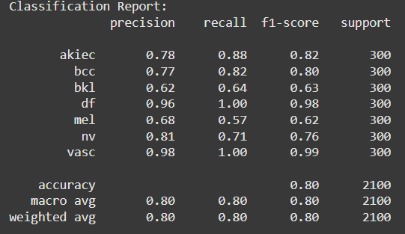
ALGORITHM AND MODEL ARCHITECTURE
Model Architecture
Image Processing Branch
Input: 224 × 224 × 3 RGB image
Conv Block 1: Conv2D(32, 3×3) → ReLU → MaxPooling(2×2)
Conv Block 2: Conv2D(64, 3×3) → ReLU → MaxPooling(2×2)
Conv Block 3: Conv2D(128, 3×3) → ReLU → MaxPooling(2×2)
Flatten → feature vector
Tabular Data Branch
Input: M‑dimensional vector (e.g. patient age, sex, lesion location, etc.)
Dense(64) → ReLU → Dropout(0.3)
Dense(32) → ReLU → Dropout(0.3)
Feature Fusion & Classification Head
Concatenate image and tabular feature vectors
Dense(128) → ReLU → Dropout(0.5)
Dense(64) → ReLU
Output Layer: Dense(C) → Softmax (C = number of classes)
Training Details
Optimizer: Adam (learning rate = 1 × 10⁻⁴)
Loss: Categorical Cross‑entropy
Batch Size: 32 Epochs: 20
Notes:
Model Architecture
Two‑Branch Multimodal CNN
Image Branch
Input: 224 × 224 × 3 RGB images
3 Conv Blocks:
Conv2D (32 filters, 3×3) → ReLU → MaxPool (2×2)
Conv2D (64 filters, 3×3) → ReLU → MaxPool (2×2)
Conv2D (128 filters, 3×3) → ReLU → MaxPool (2×2)
Flatten to 1D feature vector
Tabular Branch
Input: M‑dimensional clinical metadata
Dense(64) → ReLU → Dropout(0.3)
Dense(32) → ReLU → Dropout(0.3)
Fusion & Classification Head
Concatenate image + tabular vectors
Dense(128) → ReLU → Dropout(0.5)
Dense(64) → ReLU
Output: Dense(C) → Softmax
Training Details
Optimizer & Loss
Adam optimizer (LR = 1 × 10⁻⁴)
Categorical cross‑entropy loss
Batching & Epochs
Batch size: 32
Epochs: up to 20 with early stopping (patience = 5)
Regularization & Augmentation
Image augmentations: random flips, ±15° rotations, brightness jitter
Dropout: 0.3 in tabular branch, 0.5 after fusion
Class weights to handle label imbalance
Evaluation & Monitoring
Track validation loss & accuracy each epoch
Metrics: accuracy, recall (sensitivity), specificity, AUC
Generate Grad‑CAM heatmaps for visual explainability
Model performance was evaluated using accuracy, sensitivity (recall), specificity, and AUC on the held‑out validation set. Grad‑CAM visualizations were also generated post‑training to verify that the image branch focused on clinically relevant regions.
"batch size" refers to the number of training examples a model processes before updating its internal parameters
epoch refers to one complete pass through the entire training dataset by the learning algorithm

Slide 11
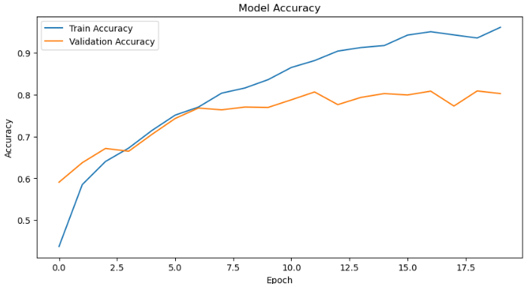
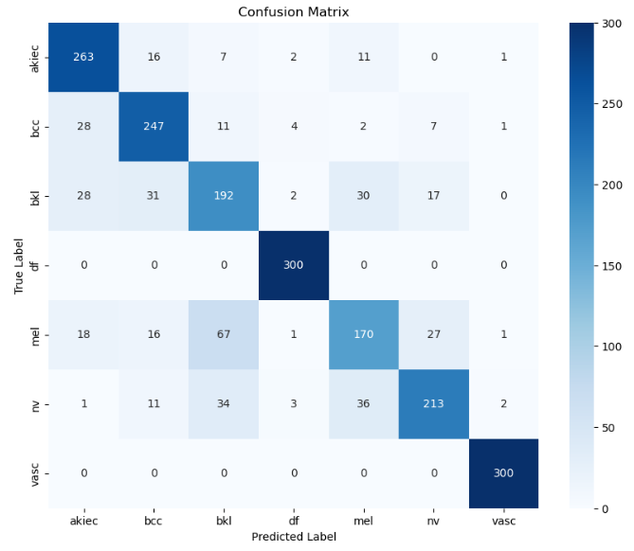
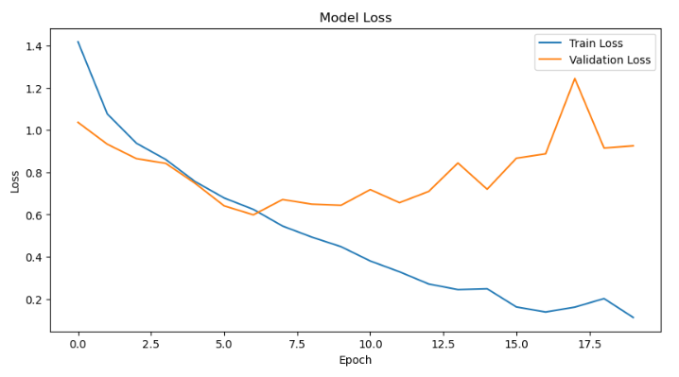
TRAINING AND EVALUATION RESULTS
Notes:
“We trained our model for 20 epochs using our custom data generator, which ensured that both image and tabular data were fed in during training.”
“As you can see from the training and validation accuracy plot, the model learned steadily over time. There was no sign of major overfitting, which means our data preprocessing and regularization worked well.”
“The final validation accuracy was approximately 80%, which shows strong performance given the complexity of the classification task.”
“To get a deeper understanding of how the model performs across different classes, we generated a confusion matrix. This helped us visualize which classes the model predicted well and which ones it had trouble with.”
“We also used a classification report to evaluate precision, recall, and F1-score. The model performed especially well on the more balanced classes and showed improvement on previously underrepresented ones due to our balancing strategy.”

Slide 12
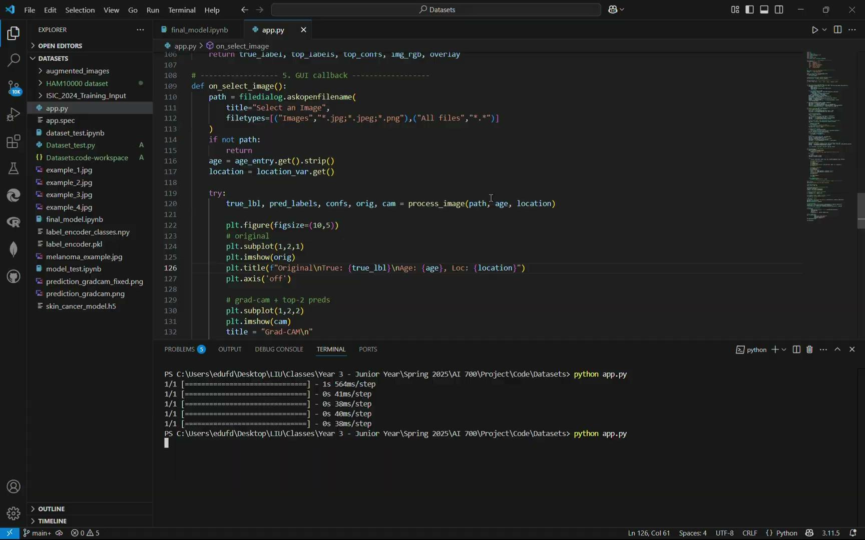
MODEL RESULTS
Conclusion
Notes:
“Now that we’ve seen how the model was built and trained, here’s a short clip showing our model in action.”
“In this example, we input a dermatoscopic image along with patient metadata — such as age, sex, and the lesion’s location on the body.”
“The model processes both inputs and outputs the predicted lesion class along with a confidence score. This mimics how a diagnostic support tool could function in a real clinical setting.”
“This demonstration shows how our multi-input model can intelligently combine visual and contextual data to make more accurate predictions.”
“You’ll notice in the clip that the model is fast and responsive — which is promising for real-time or mobile-based deployments in the future.”

Slide 13
CONCLUSION & FUTURE WORK
Conclusion
Successfully built a skin lesion classification model
Used both image and metadata for improved accuracy
Addressed key challenges like data imbalance and input diversity
Future Work
Train with larger, more diverse datasets (e.g., ISIC Archive)
Improve the Grad-CAM so that it detected better the skin lesion
Improve performance with pre-trained models like EfficientNet
Create a executable file so it’s easier to use for everyone
Notes:
“To conclude, our team successfully built a deep learning model capable of classifying skin lesions into seven different classes, including melanoma.”
“By combining both image data and patient metadata, we created a multi-input model that mimics how a real dermatologist might consider multiple factors before diagnosis.”
“We tackled several technical challenges — like class imbalance and missing data — and used smart preprocessing and data augmentation to build a balanced and robust training set.”
“We also aim to improve the model using transfer learning with architectures like EfficientNet, and potentially deploy it to a mobile or web platform for real-world use in clinics or remote settings.”

Slide 14
REFERENCES
Melanoma Research Alliance. (2024). 100,000 Americans are estimated to be diagnosed with invasive melanoma in 2024. CureMelanoma.org. https://www.curemelanoma.org/blog/100000-americans-estimated-to-be-diagnosed-with-invasive-melanoma-in-2024
Najita, J. S., Chen, M. H., McMillan, B., Stampfer, M. J., Kantoff, P. W., & Sweeney, C. J. (2012). Misdiagnosis of melanoma and its impact on patient outcomes: A retrospective study. National Library of Medicine (PMC). https://pmc.ncbi.nlm.nih.gov/articles/PMC5265802/
Centers for Disease Control and Prevention, “Skin Cancer,” CDC, Feb. 22, 2024. [Online]. Available: https://www.cdc.gov/nccdphp/priorities/skin-cancer.html
Azeem M, Kiani K, Mansouri T, Topping N. SkinLesNet: Classification of Skin Lesions and Detection of Melanoma Cancer Using a Novel Multi-Layer Deep Convolutional Neural Network. Cancers (Basel). 2023 Dec 24;16(1):108. doi: 10.3390/cancers16010108. PMID: 38201535; PMCID: PMC10778045.
Rahman, M. M., & Smith, J. A. (2023). A comprehensive evaluation study on risk level classification of melanoma by computer vision on ISIC 2016-2020 datasets. ArXiv Preprint. https://arxiv.org/abs/2302.09528
Chen, L., Patel, S., & Gupta, R. (2024). Enhanced skin cancer diagnosis using optimized CNN architecture. BMC Medical Imaging, 24(1), 56. https://doi.org/10.1186/s12880-024-01356-8

Slide 15
Questions

